Slide 1
Feature Driven Development (FDD)
Presented By: Bhawana Dahal
Pratibh Acharya

Slide 2
Introduction
Feature Driven Development is a iterative and incremental software development process.
FDD is a software process that was created to deliver frequent, working deployable code repeatedly to the customer.
FDD is considered a straight forward approach to developing software systems that is broken down into five processes.

Slide 3
History
First created by Jeff De Luca for a 50 person 15 month project.
Luca used the process again, with 250 people 18 month project.
FDD is heavily influenced by Peter Coad and his idea of using a feature list to manage requirements.

Slide 4
Why FDD ?
Many non-trivial Projects fail.
Heavy process approach doesn’t work
Inflexible and slow to adapt
Concentration is on process, not results
FDD supports
Building complex software systems
Large development teams

Slide 5
The FDD Project Lifecycle
The FDD model consists of five basic activities.
For accurate state reporting and keeping track of the software development project, milestones that mark the progress made on each feature are defined.
The Five activities are:
Develop Overall Model
Build Feature List
Plan by Feature
Design by Feature
Build by Feature

Slide 6
Continued
1. Develop Overall Model
Create overall object model
Domain walk through
Manage scope
Form Modeling Team
Informal Feature List
Model
Only major class and important functions
State relationships between major classes
Sequence Diagram
Displaying complex functional requirements
Review
Notes

Slide 7
Continued
2. Build feature list
Features List
Create Feature List Team
Feature List Creation
Prioritize the Features
Features in this respect are small client valued functions.
For Features
<action> the <result> <by | for | of | to> a(n) <object>
Example: Calculate the total purchases by a customer

Slide 8
Continued
For feature sets
<object> management
Example: Product Sales Management
For major feature sets:
<action> <ing> <a(n)> <object>
Example: Making a product sale
Review

Slide 9
Continued
3. Plan by feature
Create Project Milestones
Form the Planning team
Setting Initial Dates
Class ownership has been done by ordering and assigning features (or feature sets) as classes to chief programmers
Review

Slide 10
Continued
4. Design by feature
A design package was produced for each feature. A chief programmer selected a small group of features that are to be developed within two weeks.
Develop sequence diagrams
Refine Object Model
Review

Slide 11
Continued
5. Build by feature
Implement Classes and Methods
Code Inspection
Promote to Build
** Milestones
Since features are small, completing a feature is a relatively small task. For accurate state reporting and keeping track of the software development project it is however important to mark the progress made on each feature. FDD therefore defines six milestones per feature that are to be completed sequentially. The first three milestones are completed during the Design By Feature activity, the last three are completed during the Build By Feature activity.

Slide 12

Continued
Fig: Milestones

Slide 13
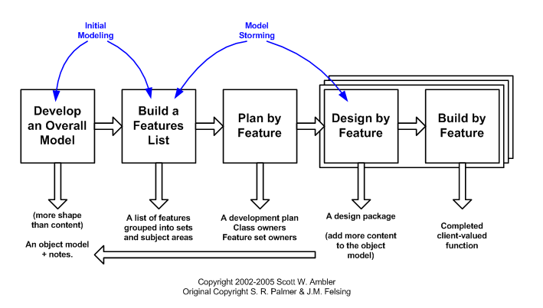
FDD Model

Slide 14
Conclusion
Adaptive Agile Model.
Successfully utilizes iterative development.
Better in team where developer’s experience varies.
Offers progress tracking and reporting capabilities.

Slide 15
Thank You

